Slide 1

Pennsylvania State
Ethics Commission
Pennsylvania Public Official and Employee Ethics Act
65 Pa. C.S. § 1101 et seq.
PSAB
JUNE 2019
Jeffery S. Frankenburger, Esquire
Investigative Counsel

Slide 2
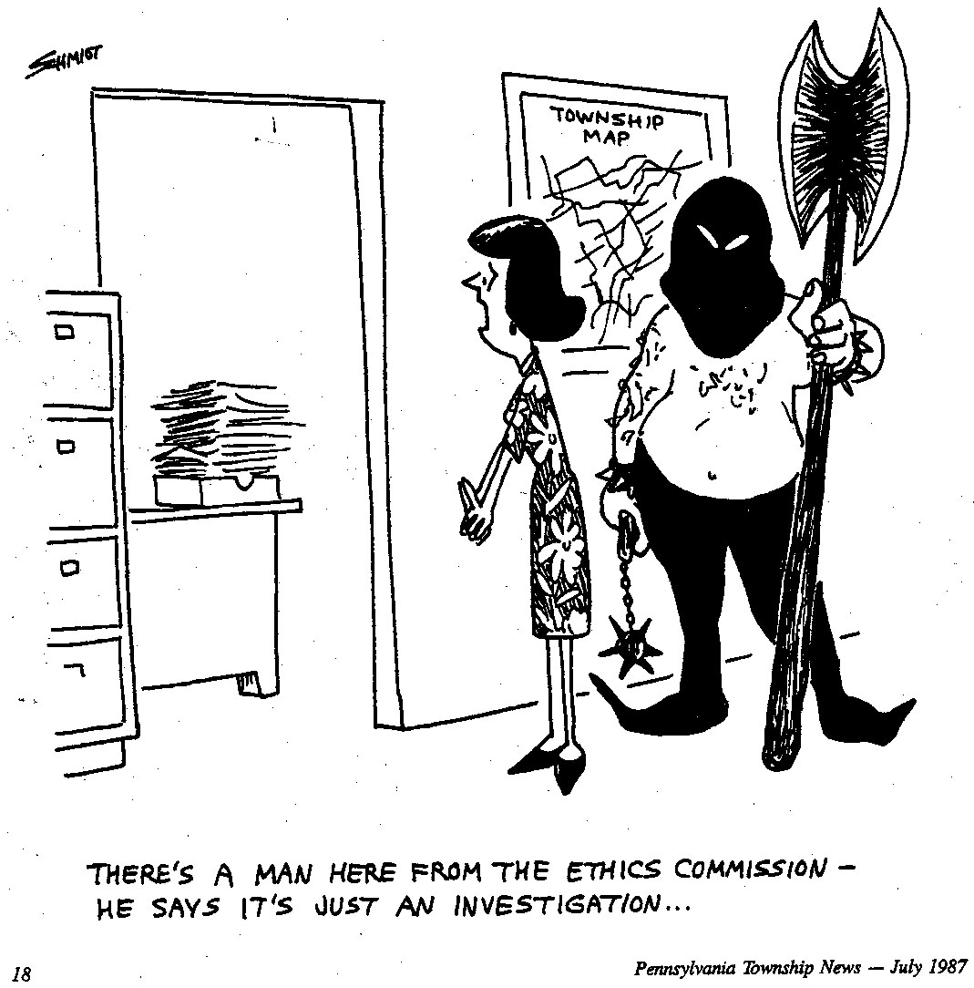

Slide 3
Mission Statement
Public Office/Employment is a Public Trust
  Any effort to realize personal financial gain through public office/employment is a violation of that trust.
Executing that Mission
Investigate alleged violations of the Ethics Act
Issue Advices and Opinions
Administer and enforce personal financial disclosure requirements.

Slide 4
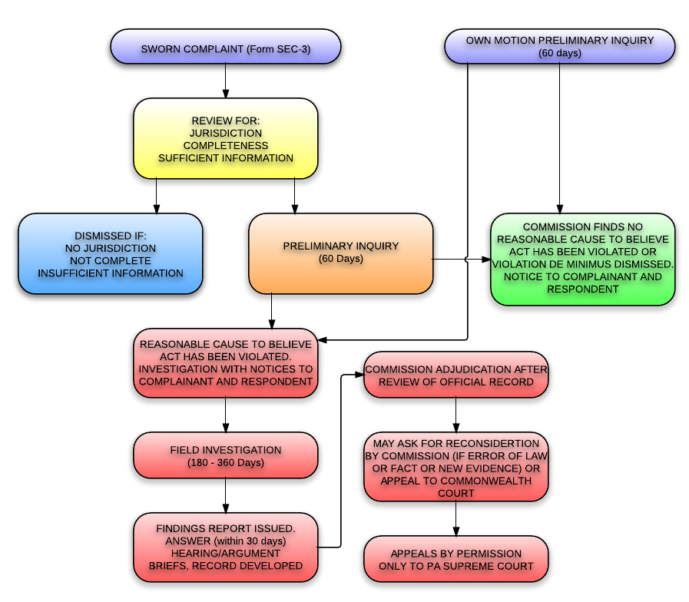

Slide 5
Public Official
Any person:
  Elected by the public
  Appointed by a governmental body
  Appointed by a governmental official
    Of any subdivision

Slide 6
Public Employee
Any individual employed by the Commonwealth or a political subdivision who is responsible for taking or recommending official action of a nonministerial nature with regard to:
  Contracting or procurement;
  Administering or monitoring grants or subsidies;
  Planning or zoning;
  Inspecting, licensing, regulating, or auditing any “person”; or
  Any other activity where the official action has an economic impact great than a de minimis nature on the interests of any “person”

Slide 7
§ 1103. RESTRICTED ACTIVITIES
(a) Conflict of Interest
(b) Seeking Improper Influence
(c) Accepting Improper Influence
(d) Honorarium
(e) Contingent and severance payments
(f) Contract
(g) Former official or employee
(h) Misuse of statement of financial interest
(i) Former executive-level employee
(j) Voting Conflict

Slide 8
Penalties
Felony - $10,000 – 5 years
Misdemeanor - $1,000 – 1 year
Restitution
Treble damages
Statements of Financial Interests deficiency $25/$250

Slide 9
Seeking improper influence
No person shall offer or give
Anything of monetary value
  A gift, loan, political contribution, reward or promise of future employment
Donor’s understanding
Vote, official action or judgment of the public official
Influenced thereby

Slide 10
Accepting Improper Influence
No public official, public employee
Shall solicit or accept
Anything of monetary value
  Gift, loan, political contribution, reward or promise of employment
Any understanding of that public official
Vote, official action, judgment
Influenced thereby

Slide 11
§ 1103(a) Conflict of Interest
A violation of Section 1103(a) occurs when:
  (1) A public official/public employee
  (2) Uses the authority if his/her office
    (2)(a) or confidential information received through his/her office/employment
  (3) For the private pecuniary benefit of:
      Himself/herself
      A member of his/her immediate family
      A business with which he/her is associated, or a member of his/her immediate family is associated

Slide 12
Definition of “Use”
“Accordingly, a public official must act in such a way as to put his office to the purpose of obtaining for himself a private pecuniary benefit. Such directed action implies awareness on the part of the public official of the potential pecuniary benefit as well as the motivation to obtain that benefit.”
Kistler v. State Ethics Commission, 22 A.3d 223, 227 (Pa. 2011)(emphasis added).

Slide 13
Definition of “Authority of Office”
The actual power provided by law, the exercise of which is necessary to the performance of duties and responsibilities unique to a particular public office or position of public employment.

Slide 14
Examples of “Use of the Authority of Office”
Advocating for the selection of yourself/immediate family/business or the rejection of competitors
  O’Brien, Advice 00-627
Discussing, conferring, and lobbying for a particular result
  Juliante, Order No. 809

Slide 15
Sivick v. State Ethics Commission, 252 C.D. 2018, decided January 3, 2019.
  Authority of office
    “The fact that Sivick abstained from voting is not dispositive when he initiated and encouraged the other Supervisors to eliminate the Nepotism Policy so the Board could vote on his son’s hiring, and then lobbied the Township to hire his Son.”
    Id. at 16.

Slide 16
Definition of “Immediate Family”
Parent
Spouse
Child
Sibling

Slide 17
Definition of “Business w/which associated”
(1) Any business
(2) that the public official/employee
(3) or an immediate family member
(4) is an owner, officer, director, employee, or has a financial interest in.

Slide 18
Sivick v. State Ethics Commission, 252 C.D. 2018, decided January 3, 2019.
  Private Pecuniary Benefit
    “ Sivick’s argument is not convincing. In Snyder (citation omitted), this Court clearly stated that, given the Ethics Act’s amendments, ‘the current conflict of interest standard . . . makes any private pecuniary gain to a public official a violation, whether or not such compensation is otherwise provided for by law.”
    Id. at 19.

Slide 19
Exceptions
An action having a de minimis economic impact
  “insignificant”
An action that affects to the same degree a class consisting of the general public
An action that affects to the same degree a subclass consisting of an industry, occupation, or other group

Slide 20
Frequent Conflict of Interest Issues
Excess expense
Vendor Contest
Surplus Property
Gifts/Travel Provided by Vendor/Contractor
Solicitations by Superiors/Regulators
Use of Personnel, Equipment, Equipment, Facilities
Nepotism
Grant Fund Manipulation
Perjury

Slide 21

Red Flags
Action with financial implication
Immediate Family involved
Hidden/Wouldn’t want public to know

Slide 22
Coulter, Order 1745
  1103a violation
      Borough Councilmember
        Utilized position to solicit and obtain a loan from a subordinate employee
        Directed Borough staff to prepare financial statements, insurance claims, and lottery paperwork for his personal business.

Slide 23
Kashnoski, Order 1738
  1103a violations
    Public official who also was employed by a bank
      Influenced Board to transfer funds to the bank where he was employed
      Accounts lost money
      Charged criminally

Slide 24
gutonski, Order 1693
  Borough Council Member
    Contacted members of the borough council individually to solicit their approval of his appointment as borough manager.
    Directly led to his appointment.
    His actions resulted in the borough not interviewing any other candidates.

Slide 25
§ 1103(f) contract
A violation of Section 1103(f) occurs when:
  (1) Public official/public employee/immediate family member/business assoc.
  (2) enters into a contract valued at $500 or more
  (3) with the governmental body of the public official/public employee
  (4) with no open and public process
    Prior public notice
    Subsequent public disclosure
      Of all proposals considered and contracts awarded
  (5) the public official/public employee shall not have any supervisory or responsibility for the implementation of the contract.

Slide 26
Advisory Opinions
Prospective
Non adversarial
Basic information
Confidential – Public
Protective status

Slide 27
Statements of Financial Interest:

Slide 28
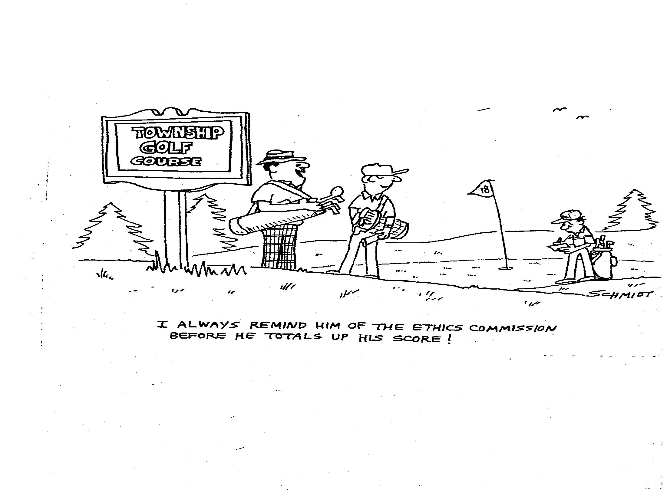

Slide 29
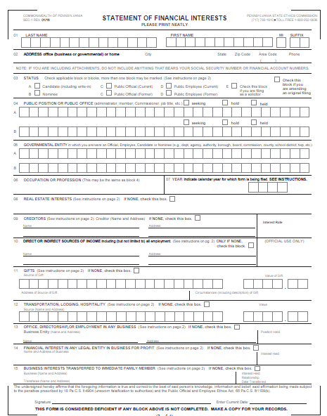
WHAT is required to be filed?

Slide 30
WHEN ... Timetable for filing
Public employees and public officials, who are not candidates must file NO later than May 1st of each year a position is held and of the year after leaving a position
Officials appointed between January 1st and May 1st must file NO later than May 1st

Slide 31
WHERE … to File
Local Officials and Employees file with their local entity.
  Authority Board
  Township
  Borough
  You may be required to file THE SAME FORM in multiple locations

Slide 32
HOW?
Paper Form
Online

Slide 33

Statement of Financial Interests
Form completion Instructions

Slide 34
Blocks 1 and 2: Name and Address
Enter your last name, first name, middle initial and suffix (if applicable)
Use your exact name as used in your official capacity
List an office (business or governmental) or home address
Include daytime telephone number

Slide 35
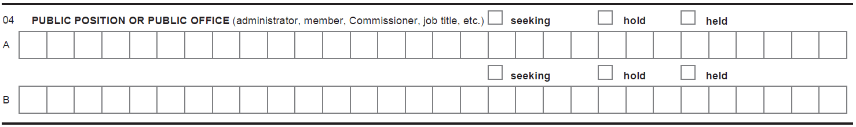
Blocks 3 and 4: Status, Public Position or Public Office
Check the block(s) to indicate your status
If correcting a prior filing, check the block at the end designating an amended filing.
Check the block (seeking, hold, held) for each position you list in blocks A and B, including positions held in the prior calendar year
If additional blocks are needed, attach a blank piece of paper with your name at the top, and list the remaining position(s)
Blocks A and B should include the official job titles (i.e., board member, commissioner).

Slide 36
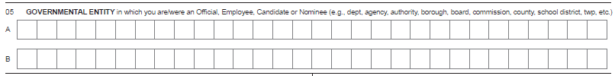
Blocks 5, 6 and 7: Governmental Entity, Occupation/Profession and Year
Block 5: List the names of all entities where you hold a position or are seeking to hold
Example: School District Name, Authority Name, Township, Borough, etc.
Block 6: List your “current” occupation or profession.
Block 7: Forms are due May 1st each year. Just like income taxes, you are always filing your form for the prior calendar year (i.e., in 2016, you are filing your form for calendar year 2015

Slide 37
Blocks 8 and 9: Real Estate Interests and Creditors
Block 8: Applies to any real estate leased, purchased or sold to or from the Commonwealth or any other governmental body within the Commonwealth in the prior calendar year.
If NONE, then check the box to the right of “none”.
Block 9: List any creditors where the balance owed was in excess of $6,500 at any time during the prior calendar year, regardless of whether such debt is held solely by you or jointly by you and any other individual (including your spouse) where each obligor is fully responsible for the obligation.
Examples: car loans, school loans, credit cards, personal loans and lines of credit.
DO NOT report a mortgage or equity loan on your home (or secondary home) or loans/credit between you and your spouse, child, parent or sibling.
If this does not apply to you, then check the box to the right of “NONE”.

Slide 38
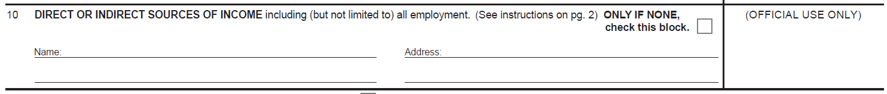
Block 10: Direct or Indirect Sources of Income
Report the name and address of each source of $1,300 or more of gross income, regardless of whether the income is received solely by you or jointly by you and another individual, such as a spouse.
However, spousal income should not be reported.
Examples of data: School District name and address, County name and address where you serve your position, or Board name and address, etc.
If you have “no” reportable sources of income, then check the box by “none”.

Slide 39
Sources of Income
“Income” : includes money or thing of value received or to be received as a claim on future services or in recognition of services rendered in the past, whether in the form of a payment, fee, salary, expense, allowance, forbearance, forgiveness, interest, dividend, royalty, rent, capital gain, reward, severance payment, proceeds for the sale of a financial interest in a corporation, professional corporation, partnership or other entity.

Slide 40
Common Income Questions
Income that should be reported:
  1) monthly pension payments where the employer has contributed in whole or in part to your pension
  2) 401K account that has generated dividends, distributions or capital gains.
Income that should not be reported:
  1) 401K accounts funded 100% by the employee
  2) An inheritance received from a family member is not considered “income” unless the inheritance would be designated as a payment for, or in recognition of, services.

Slide 41
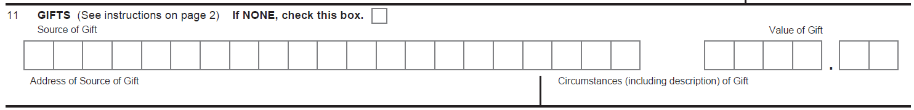
Block 11: Gifts
Block 11: for each gift(s) valued at $250 or more, list the following information: the name and address of the source, the circumstances including a description of each gift and the value of the gift(s).
DO NOT REPORT gift(s) from family members
If you did not receive any reportable gift(s), then check the box to the right of “NONE”.

Slide 42
Block 12: Transportation, Lodging and Hospitality
Block 12: List the name and address of each source and the amount of each payment/reimbursement by the source for transportation, lodging or hospitality that you received in connection with your public position if the aggregate amount of such payments/reimbursements by the source exceeds $650 for the calendar year for which you are reporting.
Do not report reimbursements made by your governmental body or by an organization/association of public officials/employees of political subdivisions that you serve in an official capacity.
Examples include: Sporting events, golf, hotel, meals, drinks, movie tickets, spa/resort, conferences
If you do not have any reportable transportation, lodging or hospitality, then check the box to the right of “NONE”.

Slide 43
Blocks 13: Office, Directorship or Employment in any Business
This block focuses solely on your status as an officer, director or employee, even if you receive no compensation for this position.
List the name and address of the business entity (including non-profit business/boards) for any office that you hold (for example, President, Vice President, Secretary, Treasurer) or any directorship that you hold(through service on a governing board such as board of directors), and any employment that you have in any capacity whatsoever, as to any business entity.
If you do not have any reportable Office, Directorship or Employment in any Business, check the box to the right of “NONE”.

Slide 44
Blocks 14 and 15: Financial Interest in any Legal Entity and Business Interests Transferred
Block 14: List the name and address and interest held in any business for profit of which you own more than 5% of the equity or assets.
If you do not have any such financial interest to report, then check the box to the right of “NONE.”
List the name and address of any business which you transferred a financial interest (as defined in item 14) to a member of your immediate family, as well as the interest held, relationship to the individual and date of transfer.
If you did not transfer any such business interest, then check “NONE”.

Slide 45
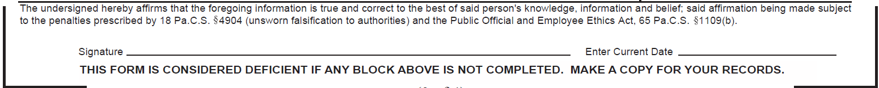
Signature and Date Block
Signature block: Sign the form and enter the current date.
IMPORTANT: Do not back date the form. Better late than never..

Slide 46
Most Common SFI Filing Errors
Block 7 – Year:
  Remember you are always filing for the prior calendar year.
Block 10 – Direct or Indirect Sources of Income:
  Many filers forget to include their primary position in Block 10.

Slide 47
SFI Form – Key Instructions
The form is considered deficient if any block is not completed or if the signature or date is missing.
Always sign the form using the current date.
Filers serving in multiple capacities will need to submit a paper version and/or a copy of their electronically filed form to all required filing locations. However, one form can be completed for all positions.

Slide 48
Statement of Financial Interests – Filing Options
The paper form is available from your entity or the Ethics Commission website as follows:
  Go to our website: www.ethics.pa.gov
  Go to the Forms and Publications section.
  Click on the link entitled “Forms Library”
  Select SEC-1 Statement of Financial Interests
  Print as many copies as needed
File online at our website:
  Go to our website: www.ethics.pa.gov
  Click on the link “Online Filing”
  Click on the link entitled “Web Statement of Financial Interests Form”
  Follow the instructions on the screen

Slide 49
WHY do I need to file?
Public Document – NO Right to Know EXCEPTION
Ethics Act dates to 1979…there was no internet. Statements of Financial Disclosure were the first line of transparency in government
Required to collect compensation from public monies (Section 1104(d) of the Ethics Act
Ungraded MISDEMEANOR if charged criminally
Civil Penalty of up to $250.00 for non-filing
Page 32 of 37
4/12/2016

Slide 50
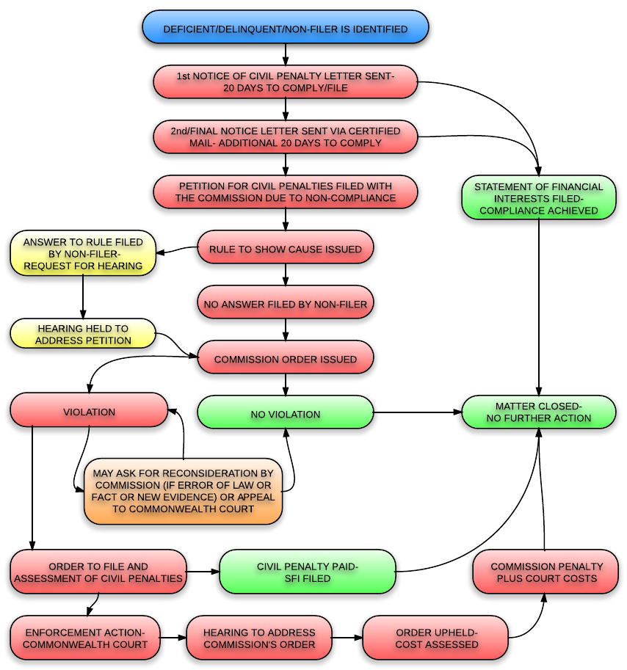

Slide 51
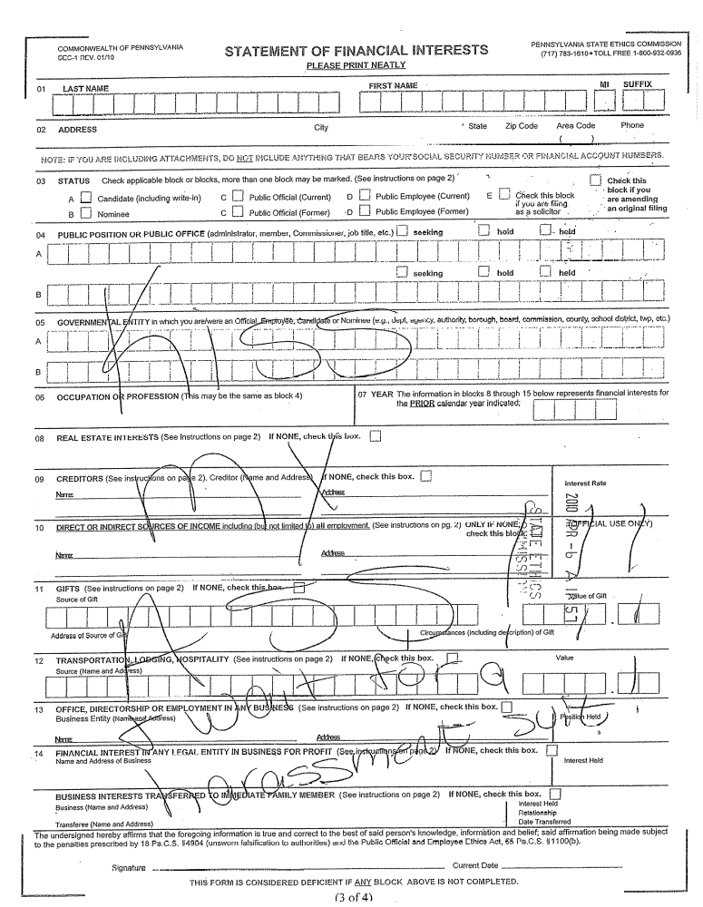
Response to First Notice Letter
First Notice of failure to file
Twenty-day grace period to file without penalty
Personally served after refusal to accept certified mailing

Slide 52
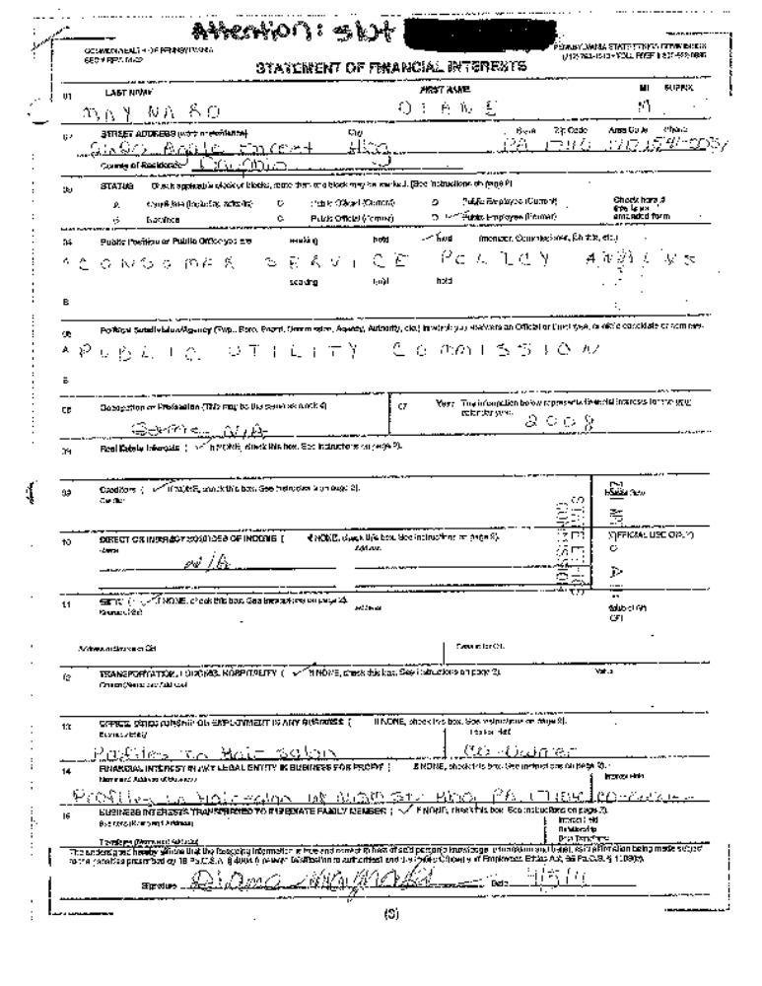
Response to Filing Petition for Civil Penalty
$250.00 Civil Penalty
Failure to File
Commission Order

Slide 53
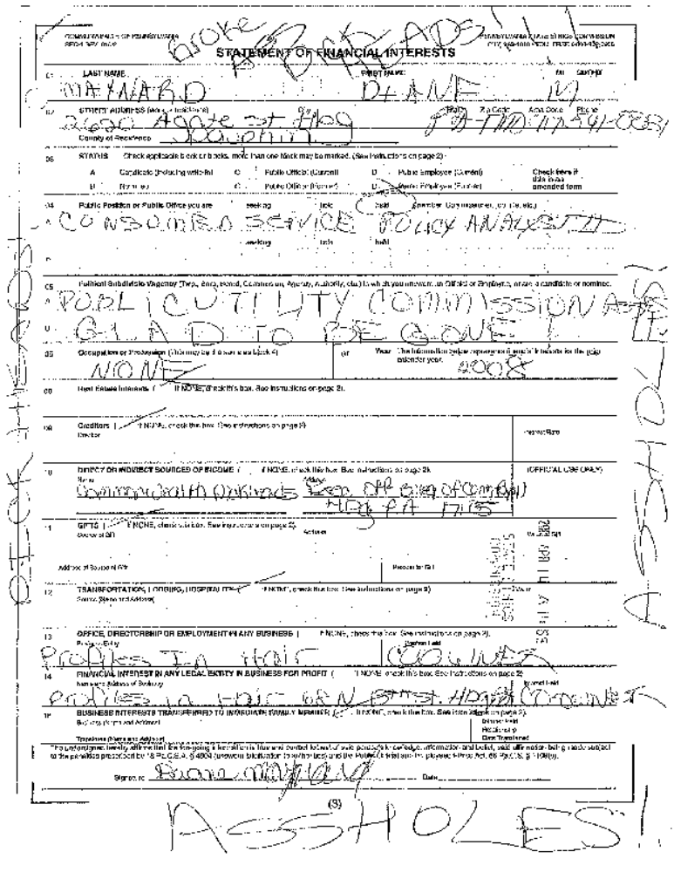
Response to Enforcement Petition
$250.00 Civil Penalty
$371.06 Court Costs
Found in Contempt of Court
Warrant for your Arrest
SFI Shown to Whole State
PRICELESS

